Slide 1

Advanced Early Dengue Prediction and Exploration Service
Dominic Ligot, Claire Tayco, Jansen Lopez, Mark Toledo
October 2019

Slide 2

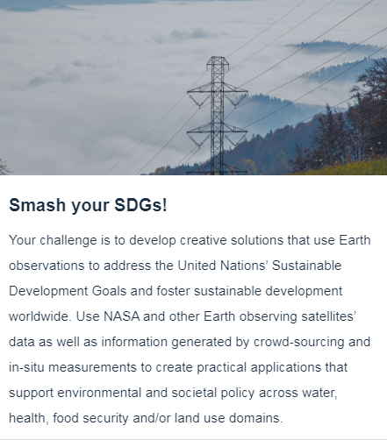

Our Challenge

Slide 3
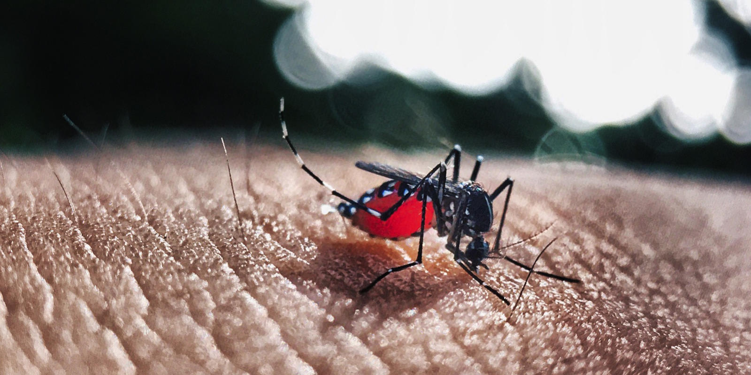
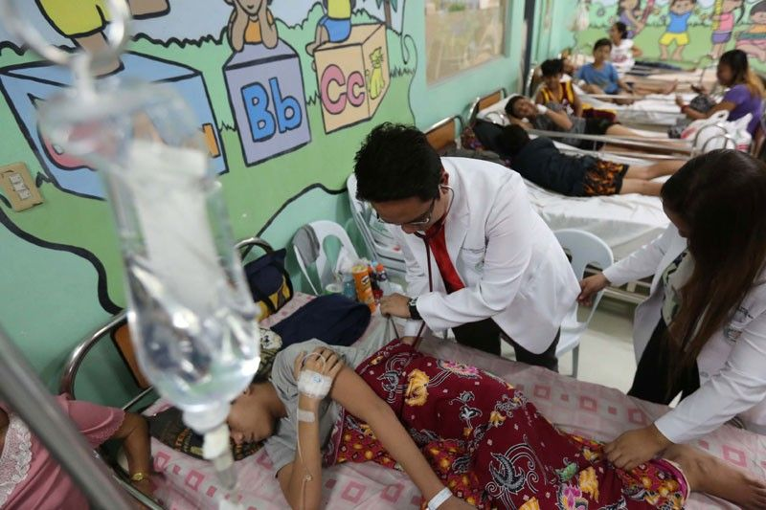
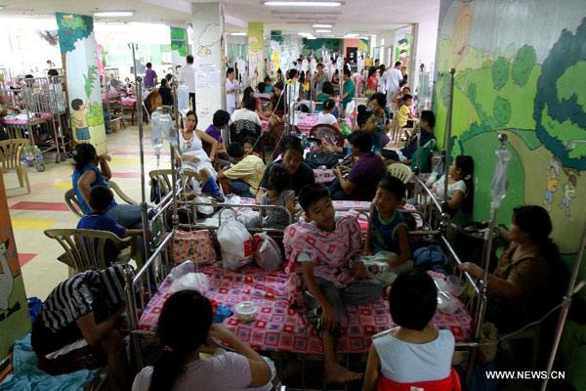
The Problem: Philippines Dengue Epidemic
1,107
271,000+
Deaths
Cases
Source: Department of Health

Slide 4
The Problem: Philippines Dengue Epidemic
1,107
271,000+
Deaths
Cases
With manual reporting dengue data is delayed by 2-3 months.
Public Health sector resources are limited.
Need to move the emphasis from treatment to prevention.
Source: Department of Health

Slide 5
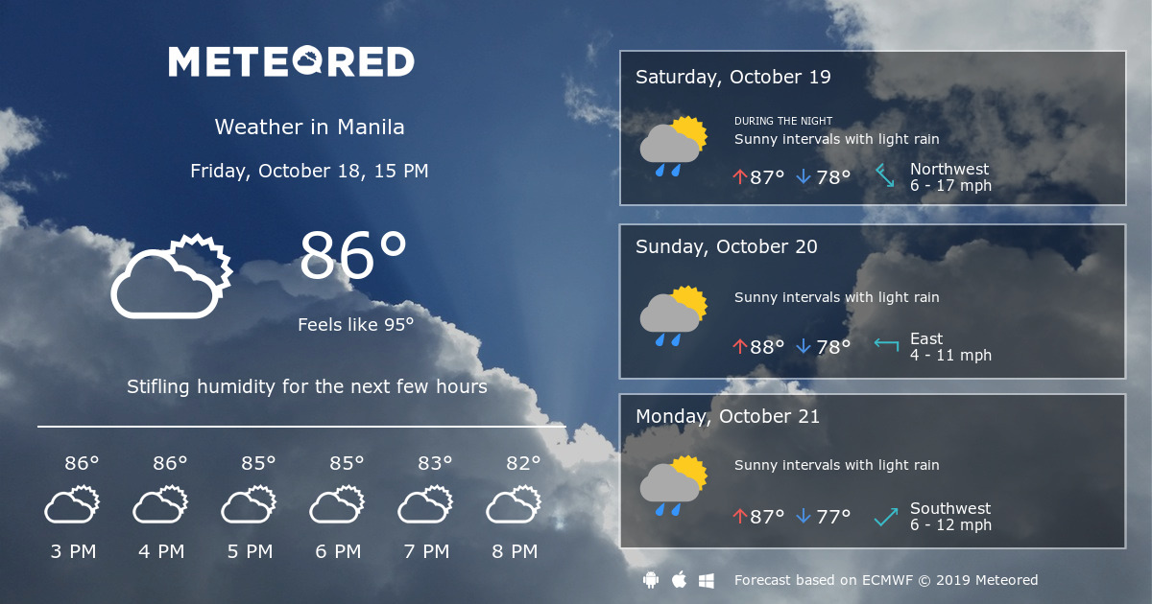
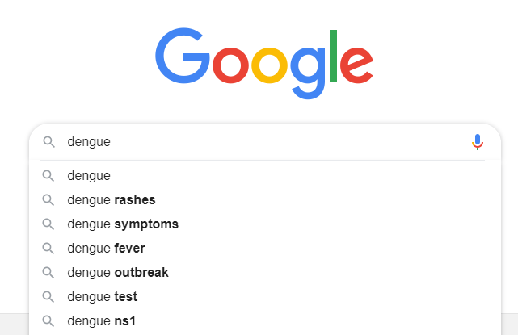
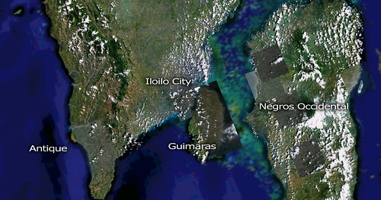
Solution: Advanced Dengue Prediction
Correlate dengue cases and deaths with real-time data from climate, google searches, and satellite maps, giving an advance indicator of when dengue will emerge and potential dengue hotspot locations.

Slide 6


Capturing The Dengue Data Cycle
Data
Data
Data
Climate
Creates mosquito breeding environments
Mosquitoes
Get infected and spread cases of disease
Searches
Triggered by public alarm and spread of cases and deaths
Deaths
Occur if cases are untreated
Reports
Cases and deaths are reported to Department of Health (2-3 months lag)

Slide 7
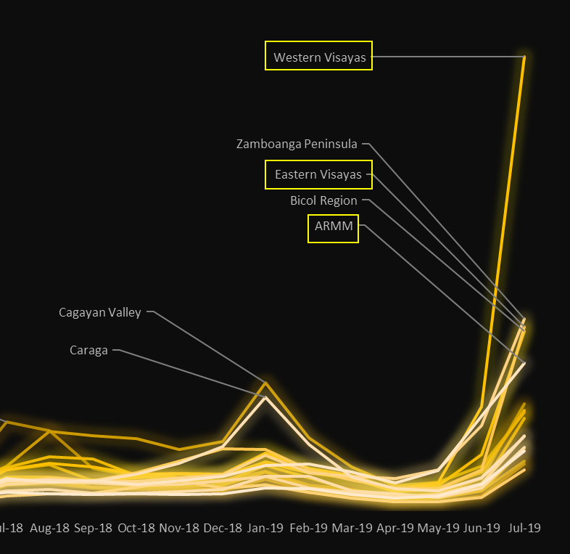
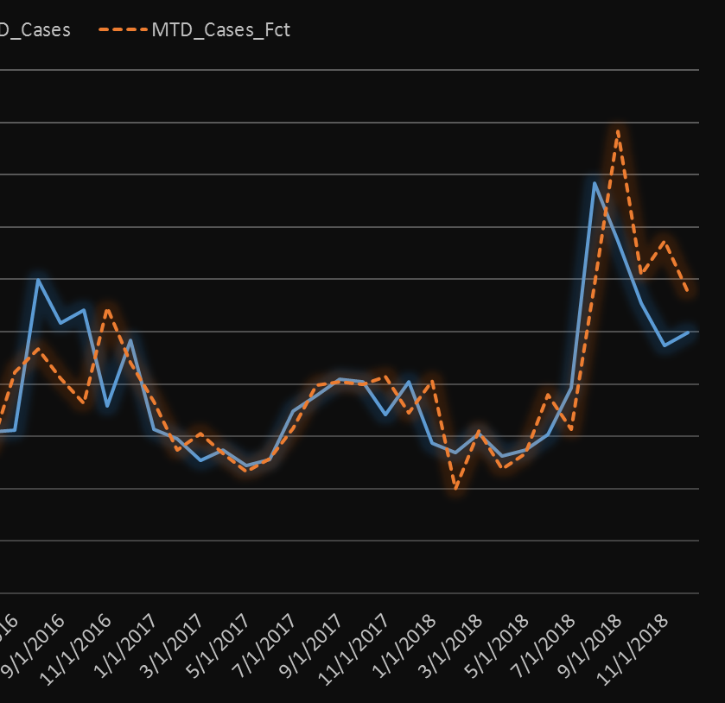
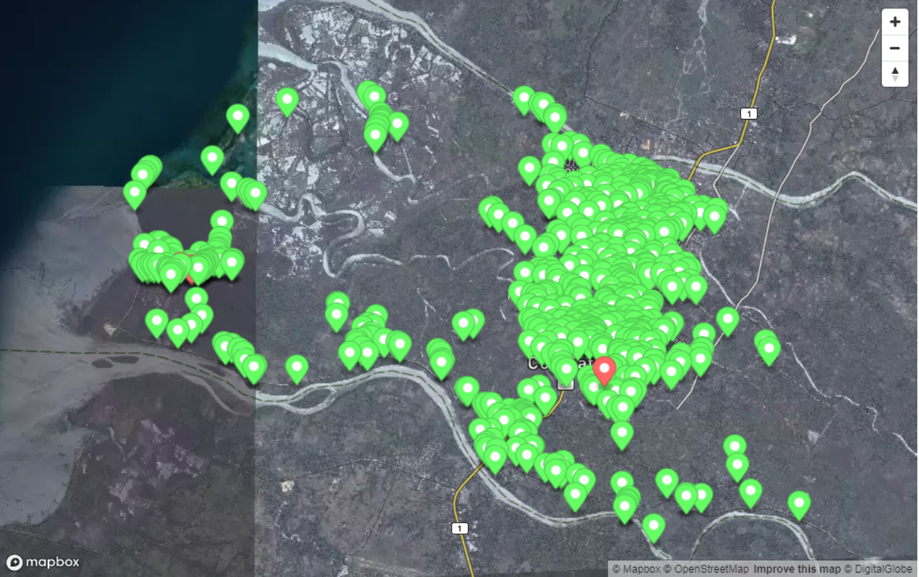
Data-Driven Dengue Portal
Descriptive
Surface and visualize existing dengue trends
Predictive Establish contributing factors and project likely dengue trends
Prescriptive
Provide guidance on areas to target for dengue mitigation

Slide 8
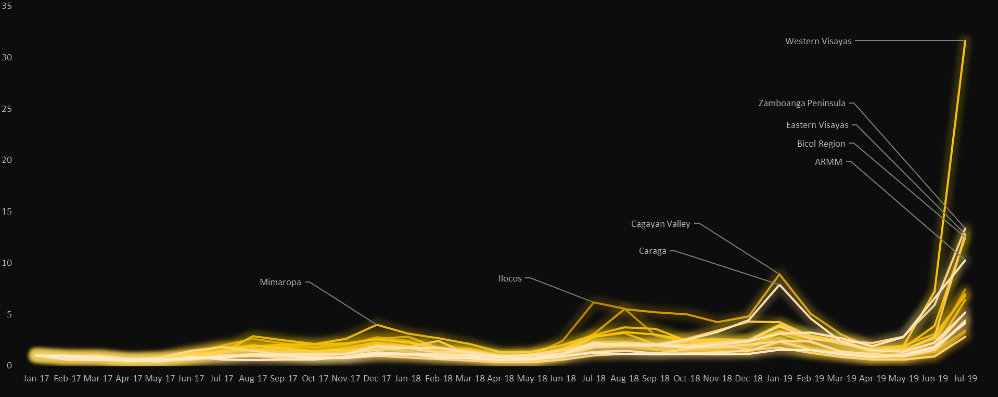
Searches for Dengue: Epidemic of Panic
Source: Google Searches (% Growth, January 2017 = 1)

Slide 9
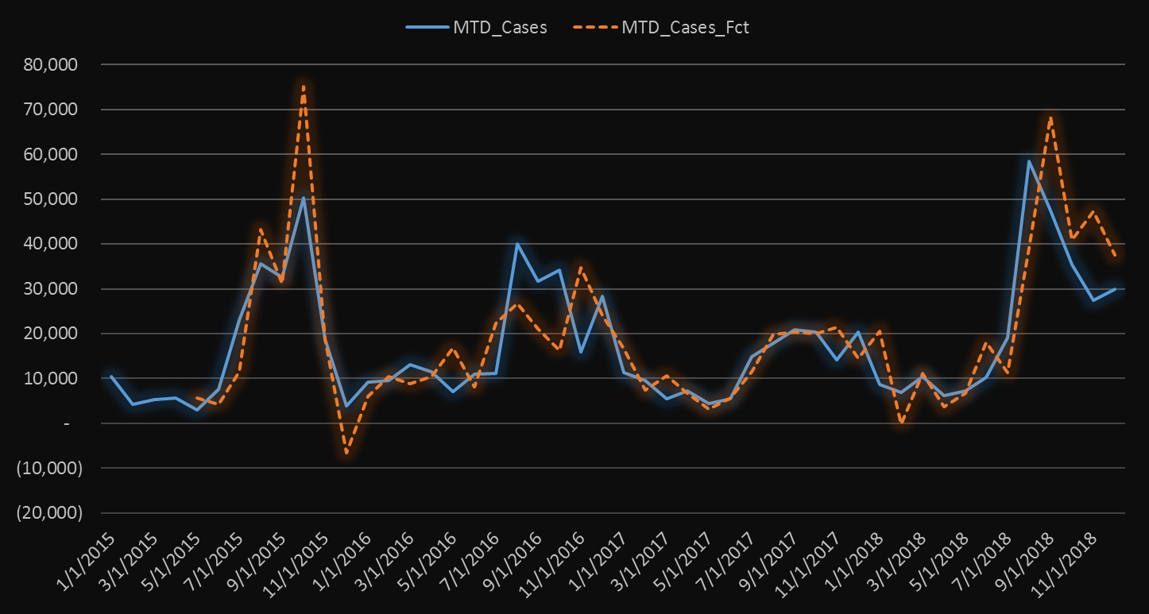
Predicting Dengue Cases
Factors:
Average Monthly Regular Temperature
Average Monthly Rainfall
Google Searches for ‘dengue’, ‘dengue symptoms’, ‘dengue cure’, ‘dengue medicine’
Lagged values for factors and cases
R 0.82 / R2 0.67
Sources: DOST-PAGASA Climate Data, Google Search Trends, DOH Dengue Monitoring Reports

Slide 10

Mosquito Hotspots From Satellite Images
Factors:
Fraction of Absorbed Photosynthetically Active Radiation (FAPAR) to identify areas with vegetation.
Normalized Difference Water Index (NDWI) to identify areas with water.
Sources: Copernicus Sentinel Data Hub, QGIS, OpenStreetMap, Mapbox

Slide 11
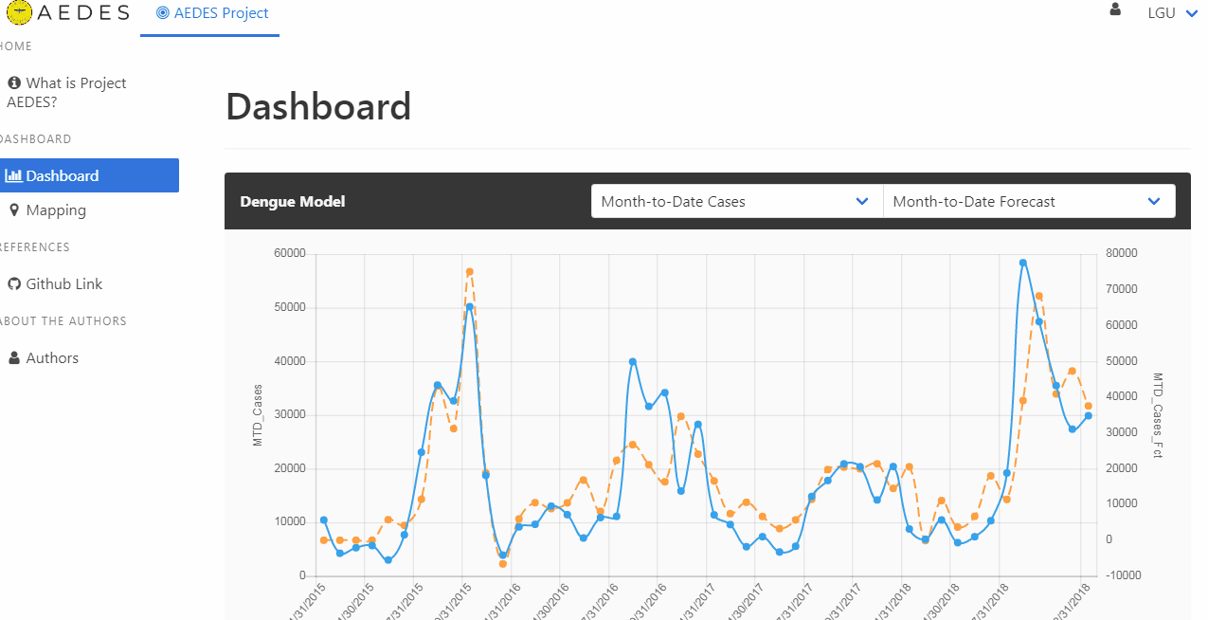
AEDES Project: Making Dengue Data Accessible

Slide 12
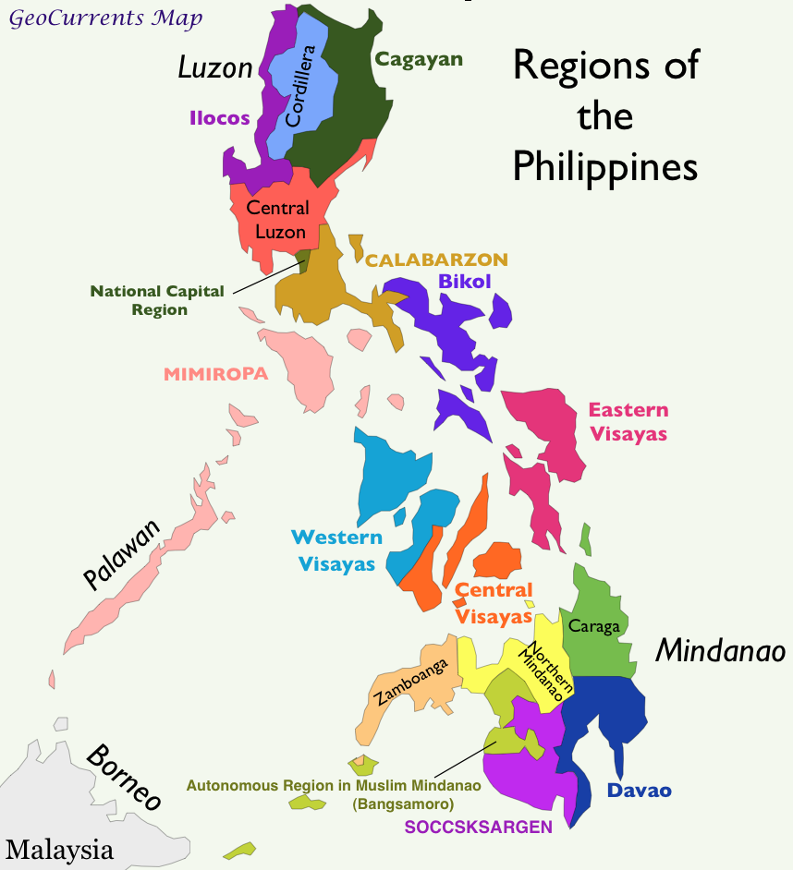
Target Beneficiaries
Free to access dashboard for public use
Target user: National and Local Government Health Departments
Use it to generate localized dengue alerts and also target areas for interventions such as fumigation, misting, inoculations and medical supplies.

Slide 13
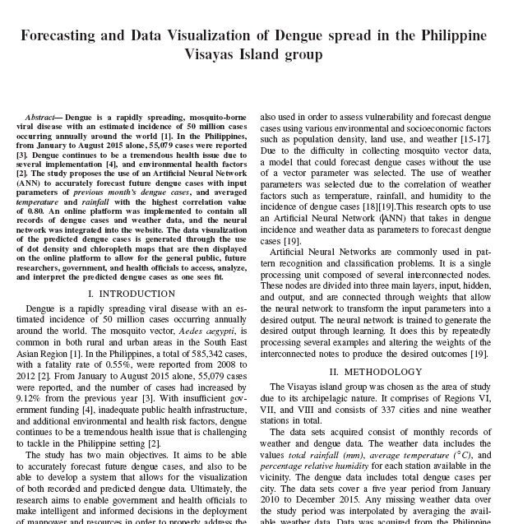
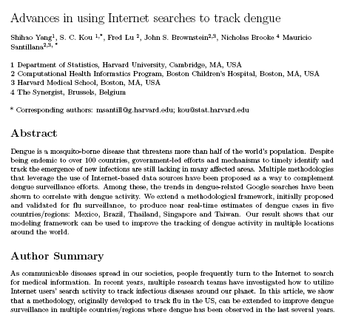
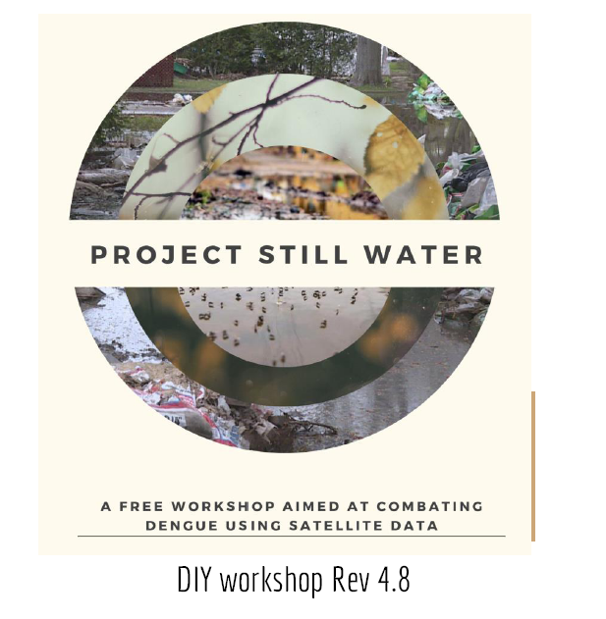
Related Literature
Caro, et. al. 2016
Yang, et. al. 2016
Chua et. al. 2018

Slide 14
Our Impact
For every single day we can reduce the lag in response time we save:
5
1,130
Lives
New Cases

Slide 15
Next Steps
Source funding support to conclude data gathering and models and maintain data platform.
Complete time-series training and testing for all regions, add satellite data for all target regions
Recommend target areas for on the ground dengue case and deaths monitoring
Set future thresholds for dengue epidemics and short list areas that will be hit first

Slide 16




Team AEDES
Dominic Ligot Project Lead
Claire Tayco Statistical Models
Jansen Lopez Geospatial Models
Mark Toledo Software Engineer

Slide 17
Save Data. Save Lives.
aedesproject.org

